Slide 1
Sprint 4 BUDS
Workflow Management System

Slide 2
Team ROles
Sophie – Scrum Master & help on front/ back end
Noah B – Front end
Gavin and Noah M – Back end

Slide 3
Goals for Sprint 4
Create a way to update Product table and delete from all tables except User ✔
Add a validation to delete a user to make sure the user exists ✔
Finish class creation for Product and Raw Materials tables ✔
Check to see if a user already exists before adding a new user ✔
Finish using roles to separate access for creation/modification ✔
Delete “Remember Me” from login ✔
Press “Enter” to login rather than clicking the login button ✔

Slide 4
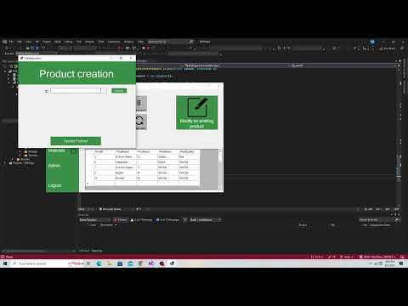
Demo

Slide 5
Happiness
“Happy people simply do better – at home, at work, in life”
Our team has created an environment where we can trust one another
We have been able to come up to solutions to problems without blaming anyone
By seeing improvement every Sprint, we have been able to see exactly how we contribute to our goals
We understand that no one is more important than anyone else

Slide 6
Goals For Sprint 5
Streamline interactions between product and raw materials table
Have stock of raw materials decrease with new product creation
Create report functions
PDF of each table, showcasing updates to product
Further refine GUI to accommodate for resizing
Create back-end and front-end code for interactions between Product and Raw Materials

Slide 7
Questions?

